Slide 1
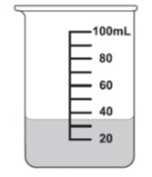
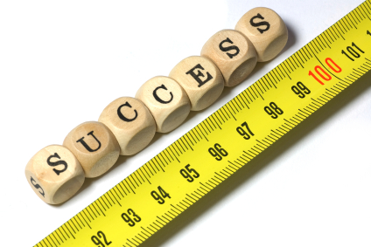
Interactive Notebook- VOLUME
Name
Class
Teacher
Term 4 Semester 2
1

Slide 2
Contents
Glossary or Formula Page
Page
Date
Description
2
3

Slide 3
Tasks
24
7
30
Essential Question
Questions
Notes
Summary
4
5

Slide 4
Warm up
Mental maths-
72
Is the answer, so,
what is the question?
With your partner, think of as many and tricky questions as you can…. Write then on your sticky notes and place on the board under Easy, Medium or extra Hard!
Did you use indices, square roots, decimals, BIMDAS?

Slide 5
24
7
30
Date
VOLUME
EQ – What are the points of confusion for calculating Volume?
What real-world examples can you think of?
Firstly we can see Volume as a 3-D object
Say of a rectangular tissue box….
How many small cubes will fit
in it?
How many cm cubes?
Estimate……..
1-D = length,
2-D = area, so
3-D = volume or capacity
Capacity is used to measure liquids.
When do we use capacity ?
5

Slide 6
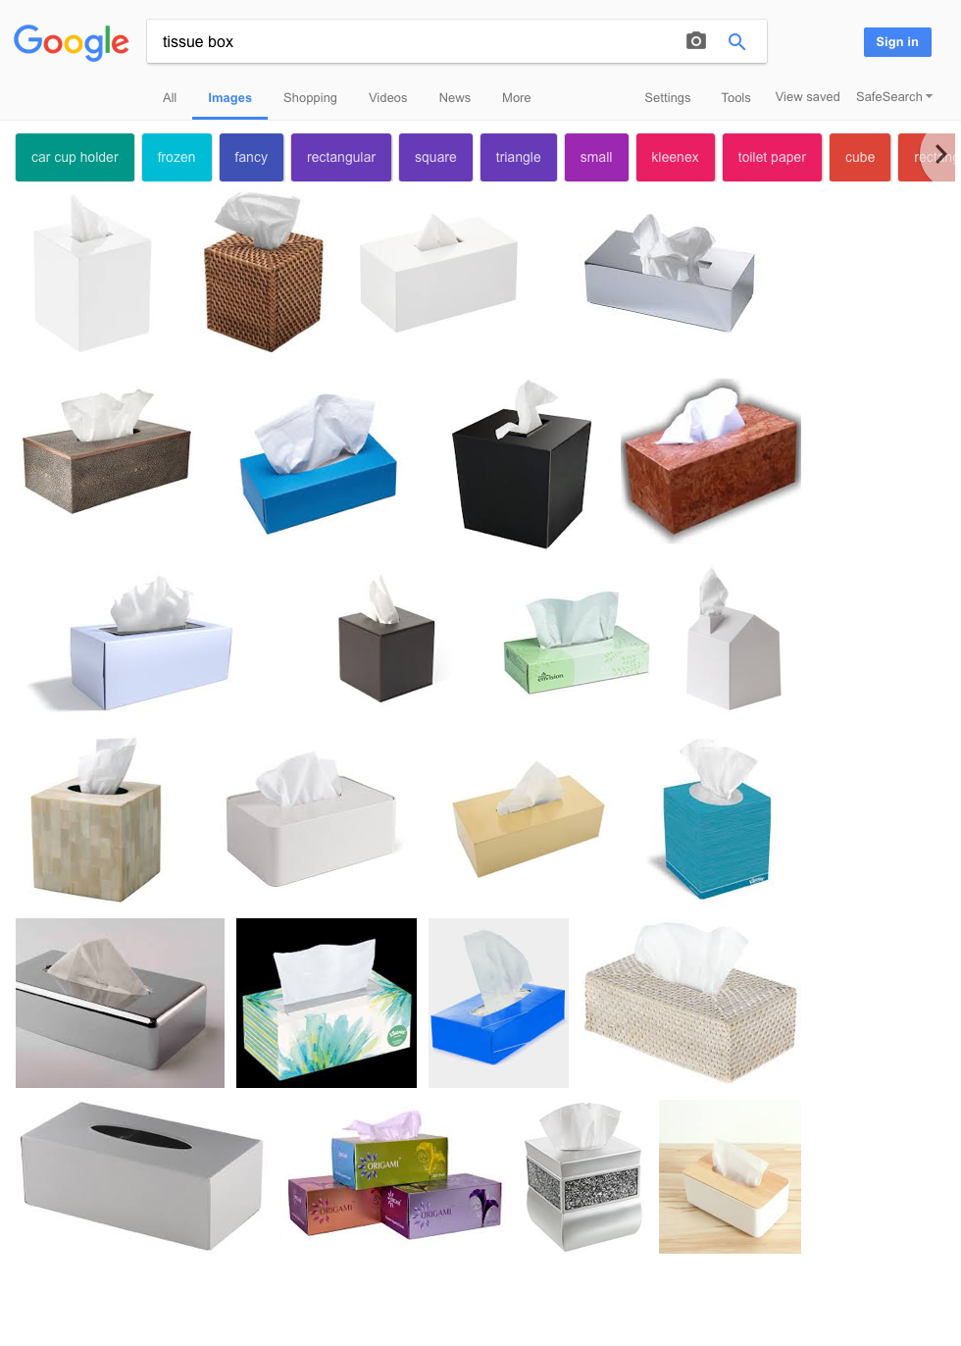
What everyday shape is a rectangular prism?

Slide 7
Check units are the same
When calculating the volume of our tissue box, we need to measure the
Length x width x height = formula L X W x H
All units must be the same unit first!
21cm long x 11cm wide x 10cms high = 231 x 10= ……. (revise how to x11 rule….)

Slide 8
x11
21 x 11 = 231
32 x 11 = 352
45 x 11= 495
Who gets the rule?

Slide 9
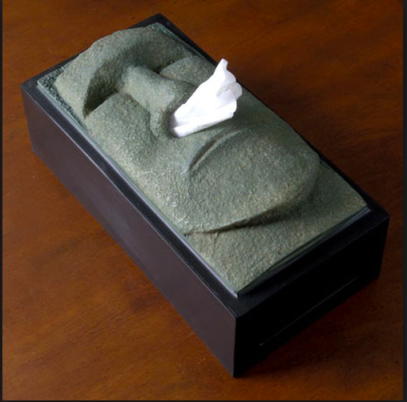
Investigate weird & wonderful tissue boxes on your i-pad

Slide 10
What is missing?
2310
cm
Did you get this correct?
Is it complete?

Slide 11
Problem example
A tissue box measures
1.2 m x 25 cm x 3000 mm.
Which unit should we convert to?
What can we use to convert units?

Slide 12
Conversion caterpillar!
Draw your own conversion caterpillar in a quick-write.
Here
(Km, m, cm, mm)
[Hide units for extension students]
2 minutes……go….

Slide 13
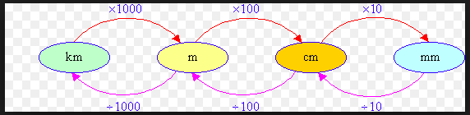
Answer
Does yours look like this?

Slide 14
Capacity- extension
What would a Capacity conversion Caterpillar look like?
Have ago here… you have 5 minutes.

Slide 15
Calculating Volumes of other 3-D shapes
If we know the area of the face of a shape , we can just multiply that by the length or height.
Such as a circular prism (cylinder) or cube
or hexagonal prism.

Slide 16
Composite shapes
Remember how we divided composite shapes up into shapes we know (such as a triangle and a rectangle) to find the area of composite shapes, then added these two areas together?
Now, we just need to do the same ie, for a kennel.

Slide 17
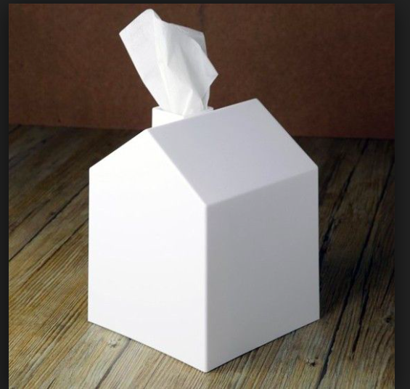
EXTENSION:
First find the volume of the triangular roof, then find the volume of the rectangular prism, then add the two together.

Slide 18
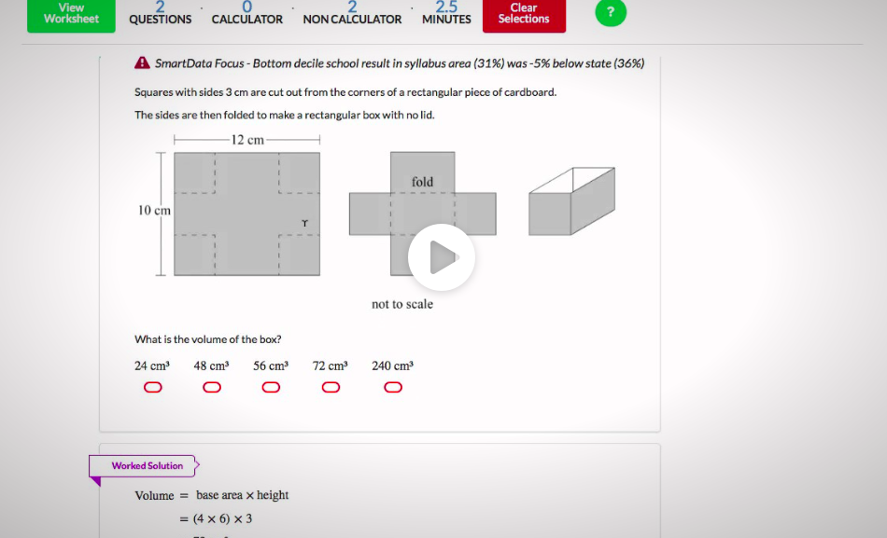
Naplan Style Question

Slide 19
Answer
First find the base,
12cm - 2(3) = 6 cm
10 - 2 (3) = 4 cm
6 x 4 = 24cm²
Then, find the height = 3cm
So, 24cm² x 3cm¹ =
**** 72 cm³ ****

Slide 20
LHS
Your turn
Pearson, fluency pp311-313
Ext: Reasoning. Pp. 314-315
And/or
Cambridge Essentials, Easy: pps 222
Medium: pps223, Enrichment p. 224

Slide 21
Summary
What can you write in this section to help you remember what to do?
Don’t forget Math space homework!
For 10 Vivos, How much liquid is in the beaker on the first slide?

